Slide 1
Communities Detection

Slide 2
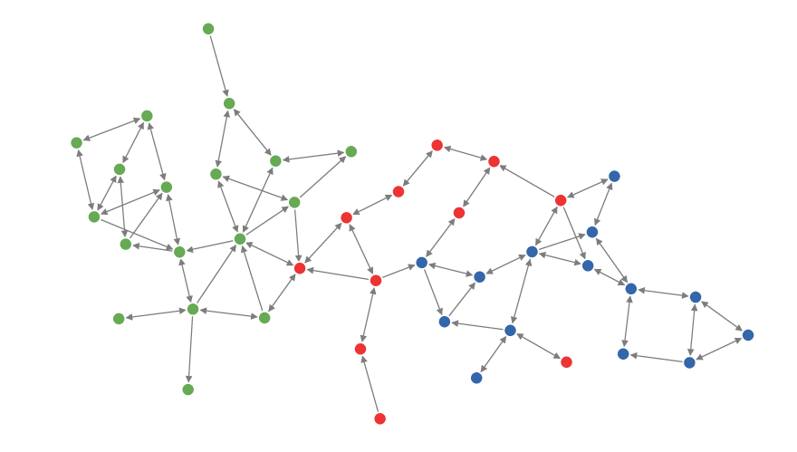
Network communities
Can you determine the number of communities in following network?

Slide 3
Network communities
What makes a community (cohesive subgroup)-
Mutuality of ties: Everyone in the group/community has ties (edges) to one another
Compactness: Closeness or reachability of group members in small number of steps, not necessarily adjacency
Density of edges: High frequency of ties within the group
Separation: Higher frequency of ties among group members compared to non-members
Community can be viewed as a summary of the whole network, and therefore easy to visualize and analyze.
Communities provide important information for applications such as market segmentation, building recommender system.

Slide 4
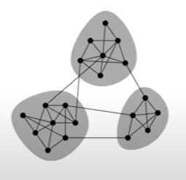
Network communities
Network communities are groups of vertices such that vertices inside the group connected with many more edges that between groups.
Will consider non-overlapping communities, each node assigned only to one community.

Slide 5
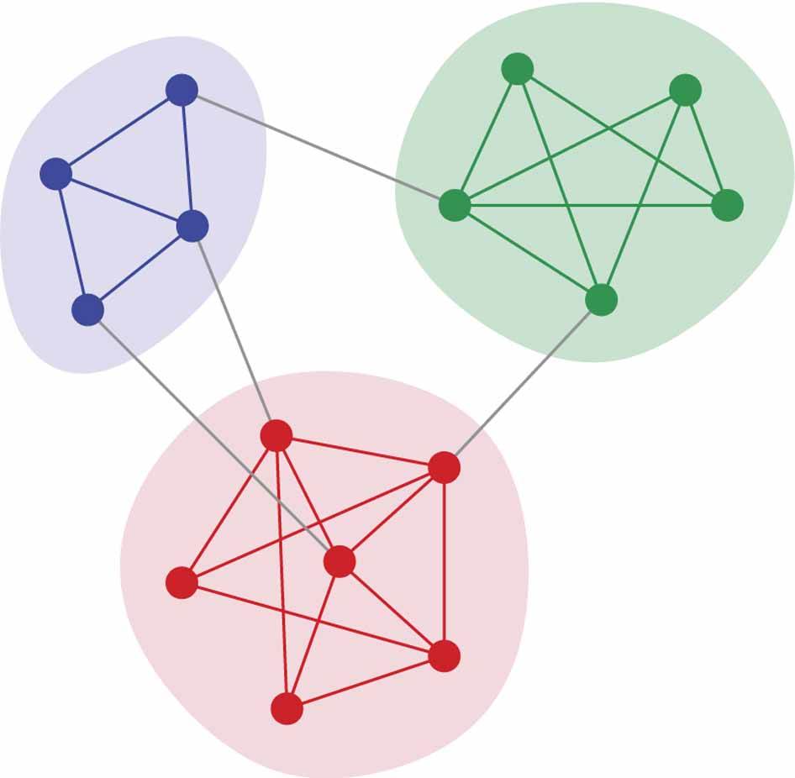
What is Community in Network?
No statistically precise definition so far
Generally speaking, a community is a set of nodes densely connected internally
Nodes between two communities are loosely connected

Slide 6
Network Clustering Algorithms
Based on Bridge
Hierarchical clustering
Girvan-Newman algorithm (betweenness)
Modularity maximization
Finding maximal clique
Stochastic block model
Spectral clustering-based model

Slide 7
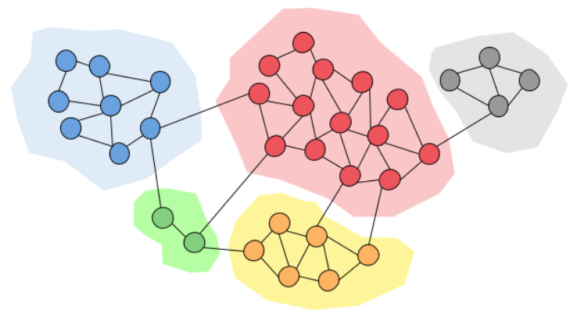
Community detection
Based on Bridge
Identify bridge edge
Remove that edge to find the communities in the network
After removing bridge

Slide 8
Community detection
Community a.k.a. clustering is used for organizing vertices (data) into groups or clusters such that there
High intra-cluster connectivity
Low inter-cluster connectivity

Slide 9
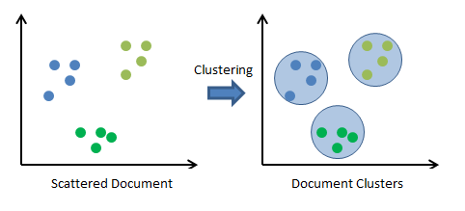
Clustering
To find the clusters in a set of data points, we require a distance measure (dij) that computes distance b/w data points i and the cluster centroid C.
Types of clustering algorithms are-
Partitional- k-means, fuzzy c-means, etc.
Hierarchical- agglomerative, divisive
Density
Graph

Slide 10
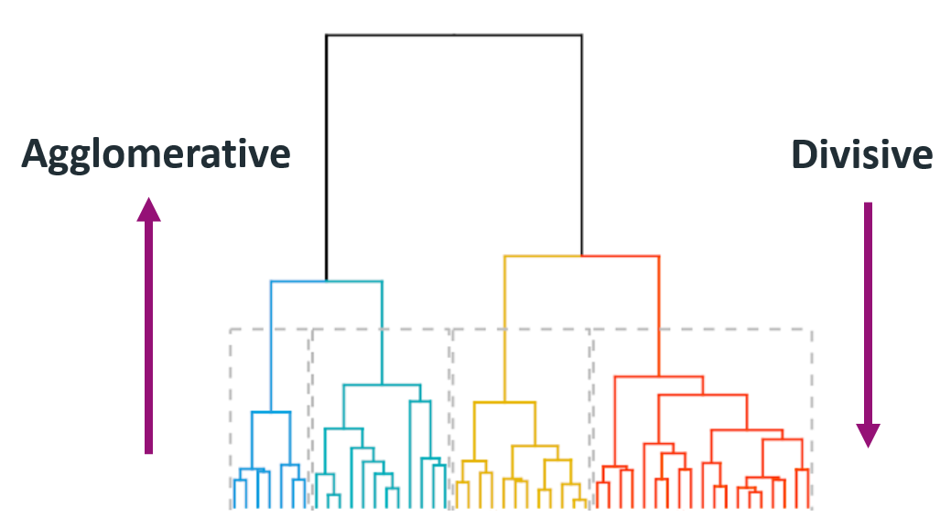
Hierarchical clustering
Data points will be present at the leaf node of the clusters
1 cluster
2 clusters

Slide 11
Clustering for Community Detection
In SNA, to identify clusters or community, create a matrix called W that stores-
the number of node independent path between each pair of node in the network.
Or
2. Create a distance matrix and apply clustering
Suppose node independent paths b/w node A to F is ACKJGYF and AOPZEF.
So, total number of path is 2 which will be the weight in the matrix between node A and F
Then apply the clustering concept to identify the number of community in the network

Slide 12
Edge Betweenness
The betweenness of an edge is defined as the number of shortest paths between any pairs of nodes in a graph G that pass through it.
Each edge in the network can be associated with an edge betweenness centrality value.
An edge with a high edge betweenness centrality score represents a bridge-like connector between two parts of a network, and the removal of which may affect the communication between many pairs of nodes through the shortest paths between them.

Slide 13
Edge Betweenness
Steps to compute edge betweenness value
1. Perform BFS traversal and find the shortest path from the starting vertex to all other vertex in graph
2. Compute the fraction of the shortest path value (local edge betweenness value)
3. Find the edge betweenness value of each edge
4. Remove edge(s) with the largest edge betweenness value to determine the correct number of communities

Slide 14
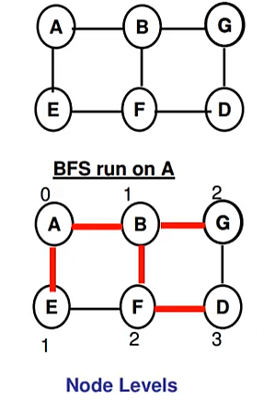
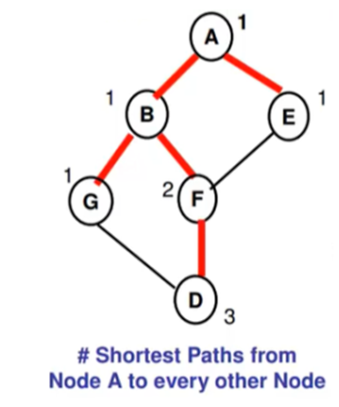
Edge Betweenness: Based on BFS
Traversal tree

Slide 15
Edge Betweenness: Based on BFS
Traversal tree
There is only one shortest path from A to B. So, assign value 1 to B. Similarly, 1 is also assigned to node E.
The value for node G = 1 (only one shorted path)
The value of node F=2 (two shortest path from A to F)
The value for node D =3 (three shortest path from A to D)

Slide 16
Edge Betweenness
Computing the fraction of Shortest Path Value
We assume 1 unit of information originates at each node.
1. Start with the node at the bottom most level and let 1 unit of info start from node D
2. Node D (3 shortest path) gets 2 of its shortest paths from node F and 1 through G. So-
Node D sends 2/3 of the info to F and 1/3 through G
Further, Node F adds received information from D to 1 unit of info originating at itself and splits the resulting (1+0.67=1.67/2) and sends (0.835) to B and E
G adds 0.33 info unit to 1 units of info originating at itself and sends 1.33 to B.
This process is repeated all vertices of the graph.

Slide 17
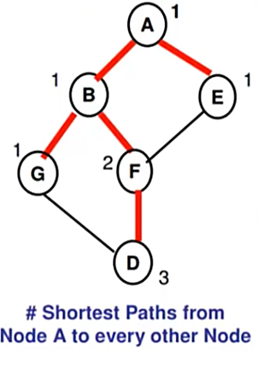
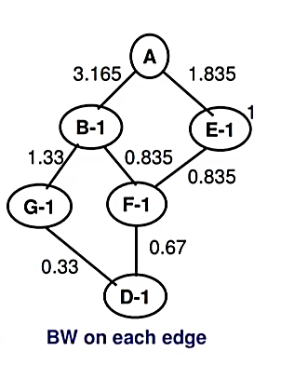
Edge Betweenness: Based on BFS
Traversal tree

Slide 18
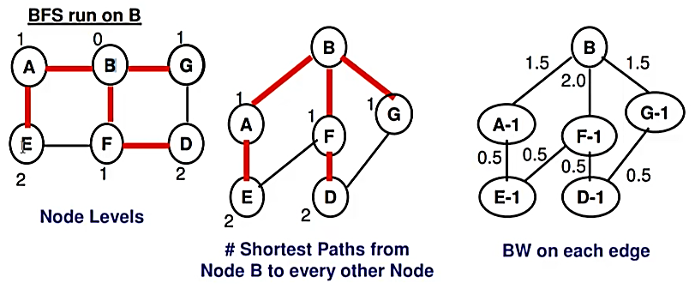
Edge Betweenness: Based on BFS

Slide 19
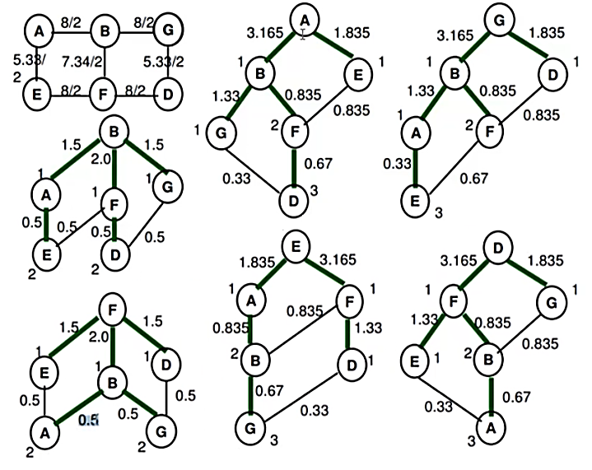
Edge Betweenness: Based on BFS

Slide 20
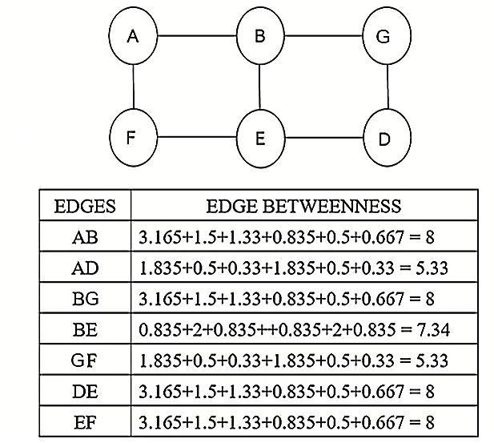
Edge Betweenness: Based on BFS

Slide 21
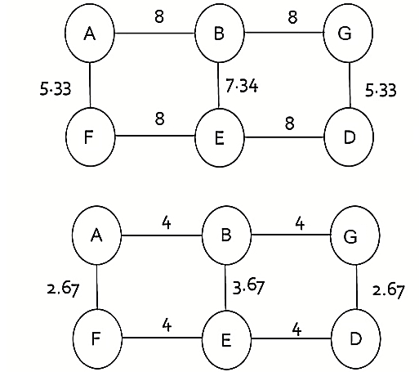
Edge Betweenness: Based on BFS

Slide 22
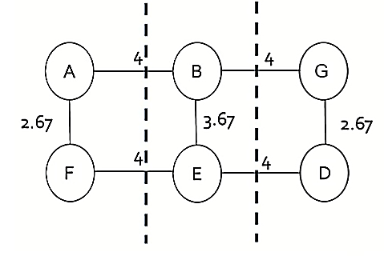
Girvan -newman community detection

Slide 23
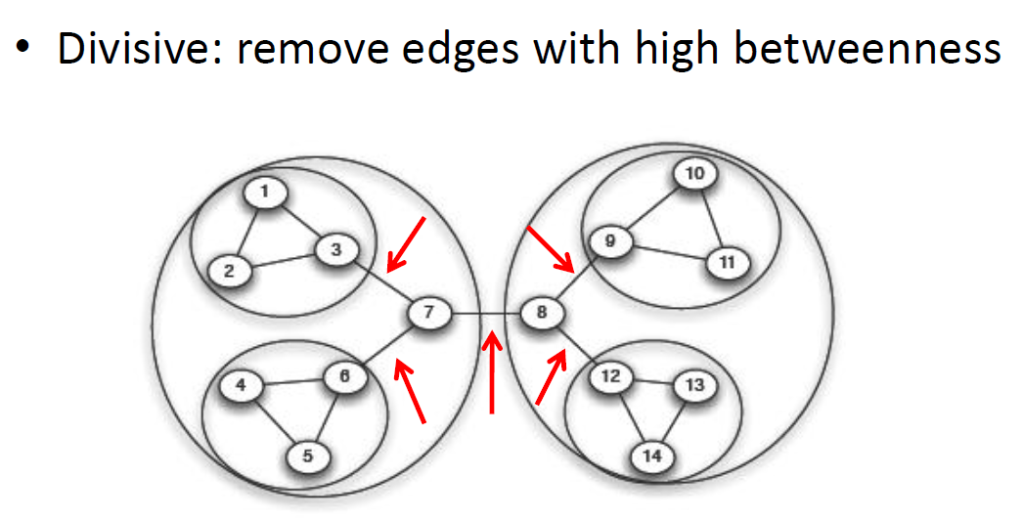
Betweenness for Partitioning

Slide 24
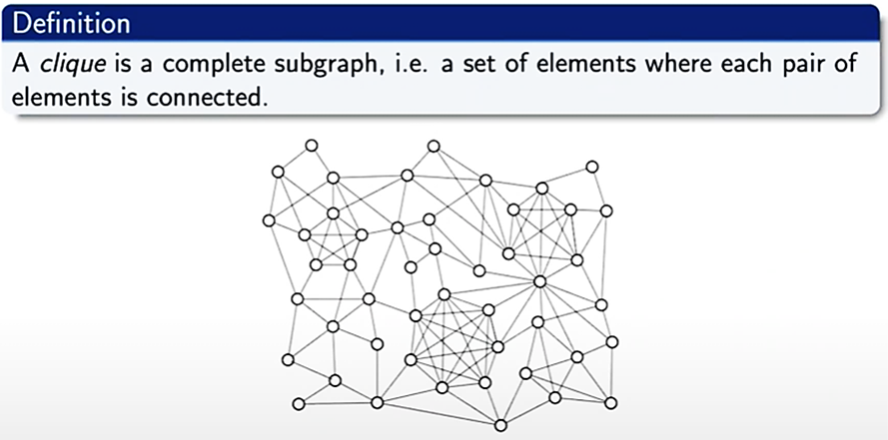
GROUP-BASED APPROCHES (Graph Cliques)
A maximal clique is a clique that cannot be extended by including one more adjacent vertex
A maximum clique is the largest maximal clique

Slide 25
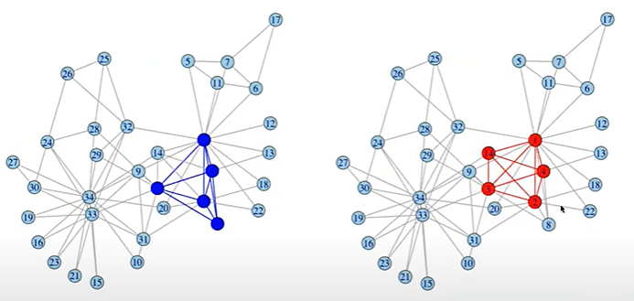
GROUP-BASED APPROCHES(Graph Cliques)
A maximal cliques:
Clique size: 2 3 4 5
Number of cliques: 11 21 2 2

Slide 26
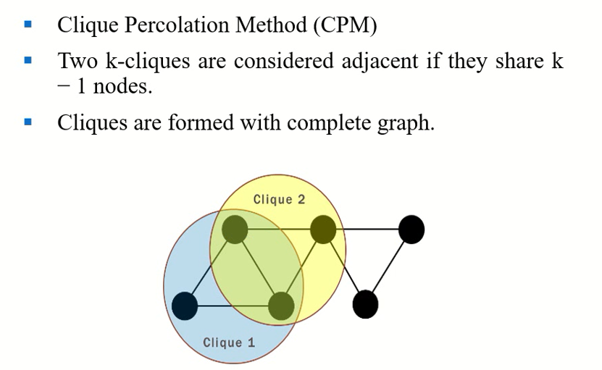
GROUP-BASED APPROCHES(Graph Cliques)

Slide 27
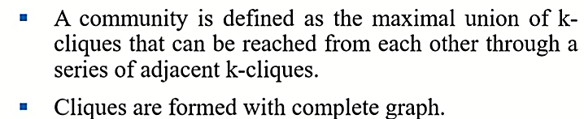
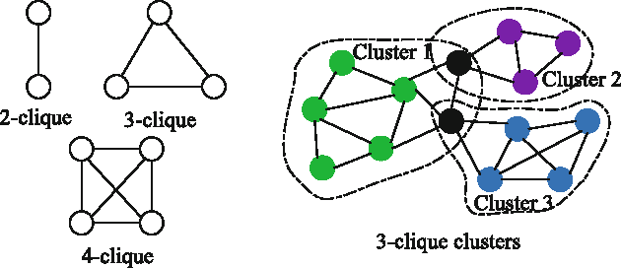
GROUP-BASED APPROCHES(Graph Cliques)

Slide 28
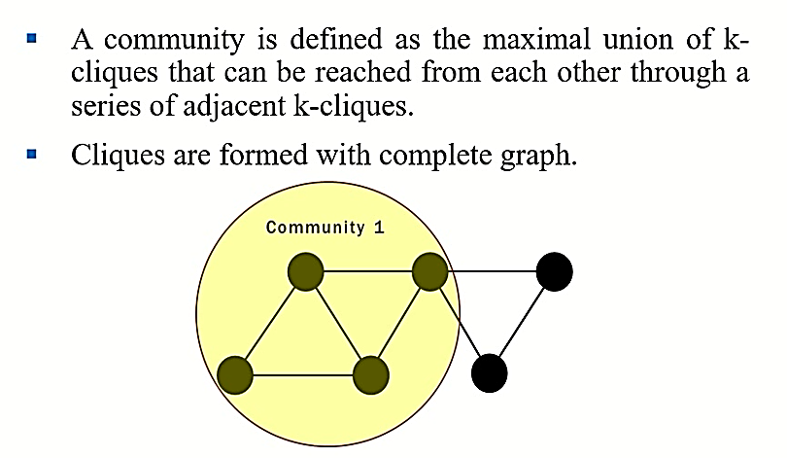
GROUP-BASED APPROCHES(Graph Cliques)

Slide 29
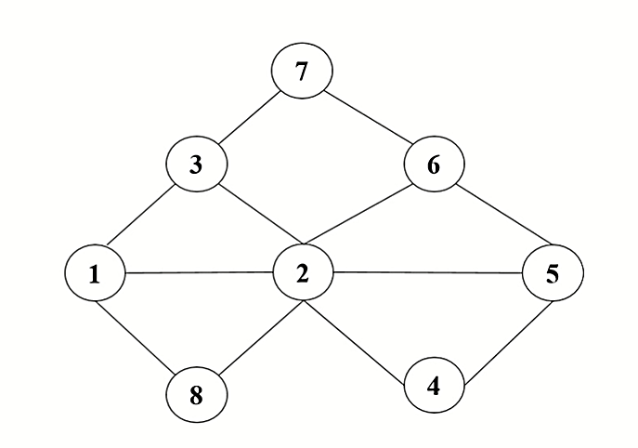
Identify Communities: Graph Cliques

Slide 30
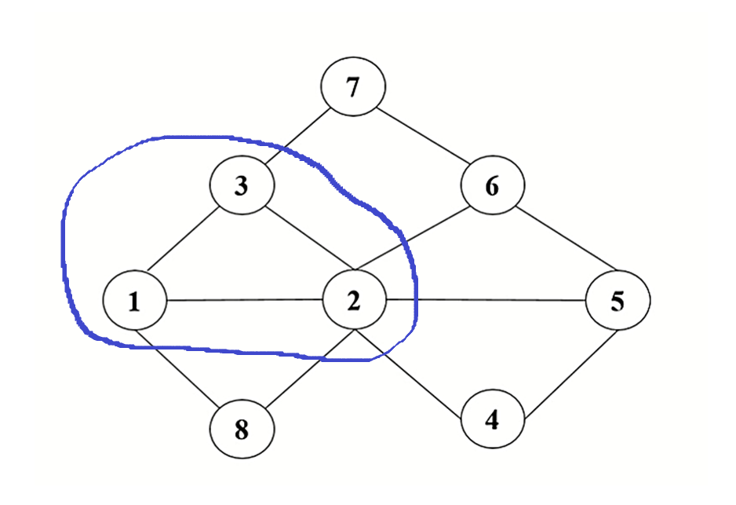
Identify Communities: Graph Cliques

Slide 31
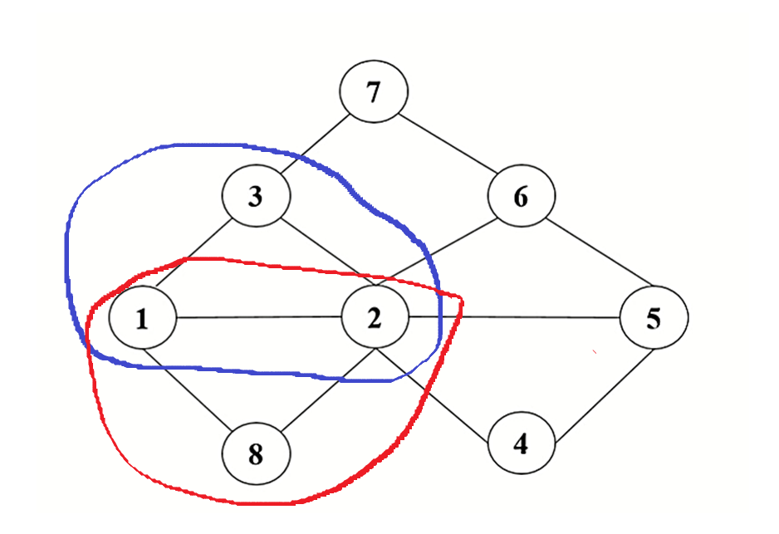
Identify Communities: Graph Cliques

Slide 32
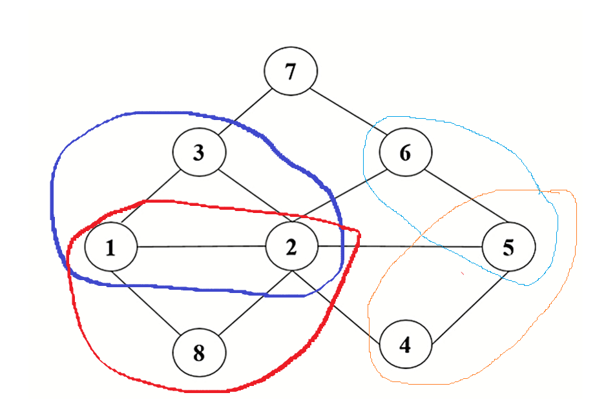
Identify Communities: Graph Cliques
Number of communities = 3
(1, 2, 3, 8), (4, 5, 6) (7)
or
(1, 2, 3, 8), (5, 6, 7) (4)

Slide 33
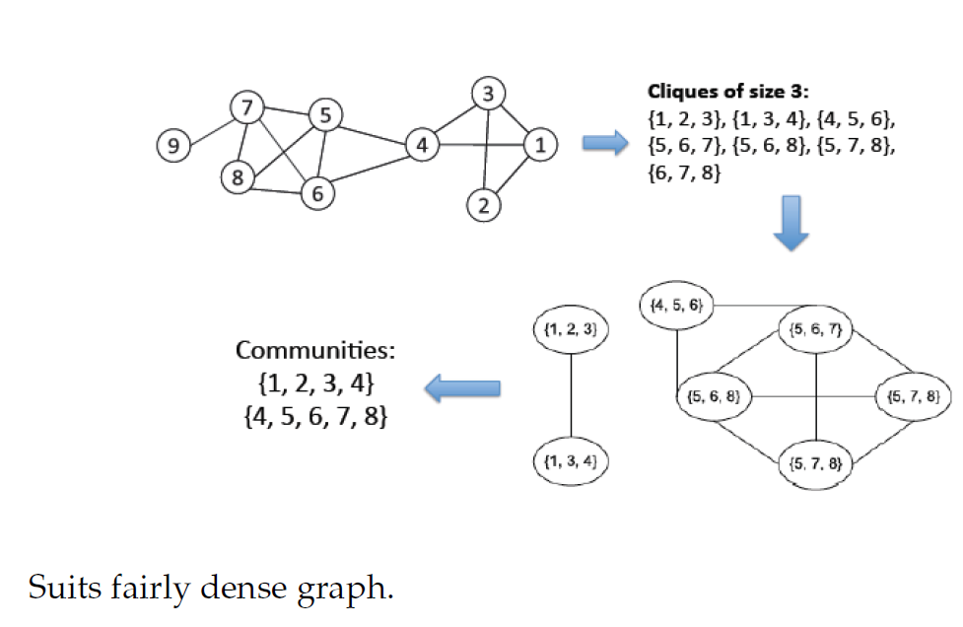
Graph Cliques

Slide 34
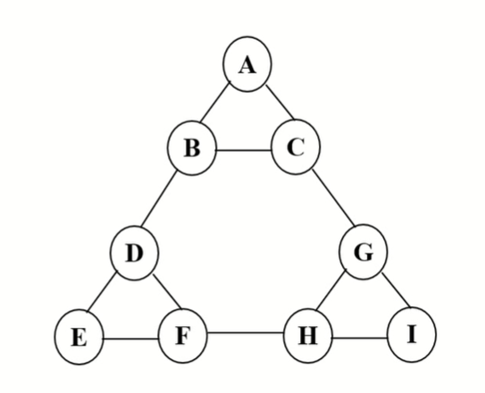
Identify Communities
Edge-betweenness centrality
K-Clique(s)

Slide 35
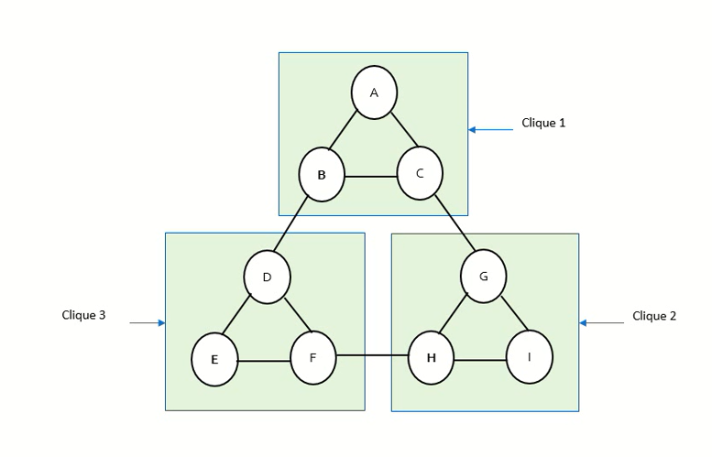
Identify Communities
There is no common node, so cliques cannot be merge. In these types of problems, some temporary edges are created to identify communities.

Slide 36
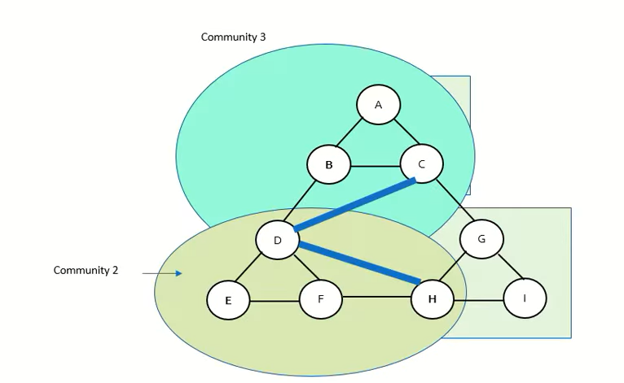
Identify Communities

Slide 37
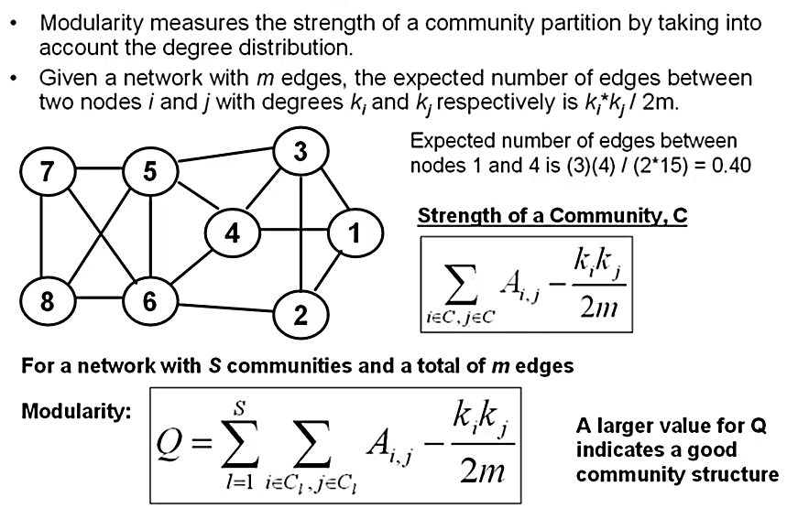
Community detection using modularity
A i, j =1 if there is an edge b/w i and j
Else 0

Slide 38
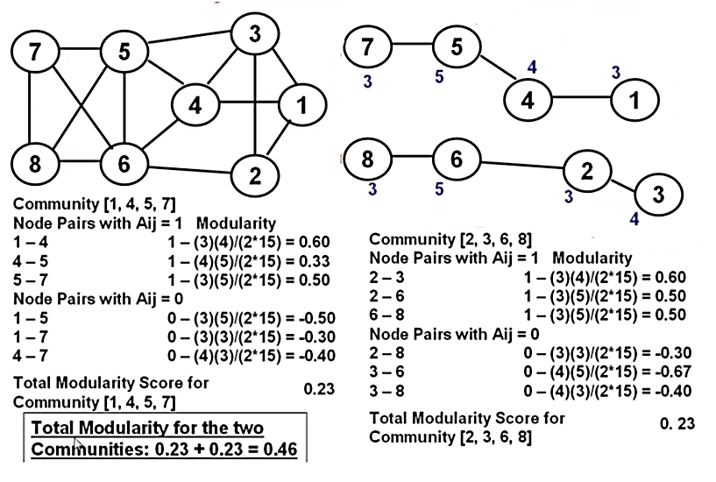
Community detection using modularity

Slide 39
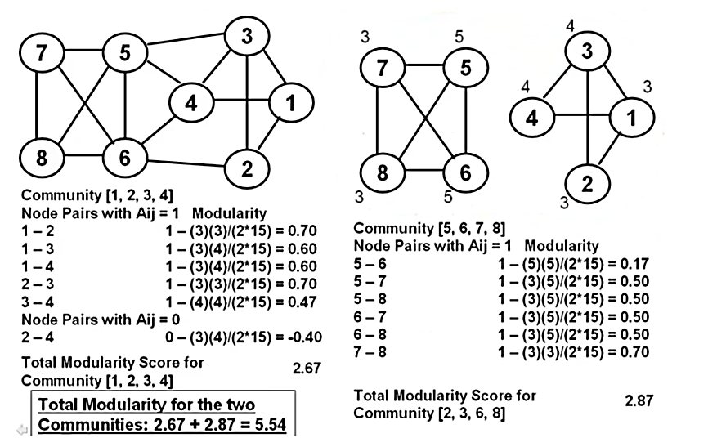
Community detection using modularity

Slide 40
Community detection using modularity
(i) Modularity score= 5.54
(ii) Modularity score=0.46
Which structure will be preferred?

Slide 41
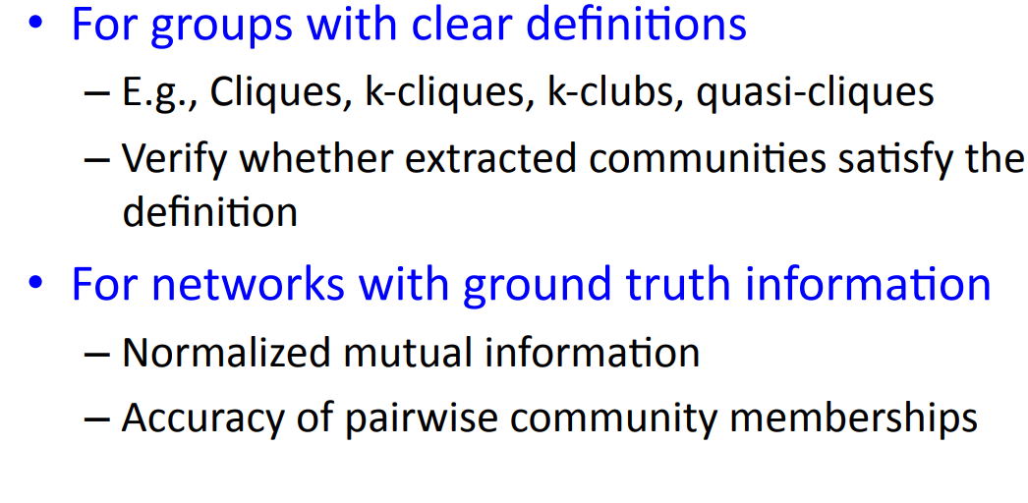
Community evaluation
To evaluate the quality of communities with ground truth, following metrics are used:
Rand index
NMI
Dunn Index
etc.

Slide 42
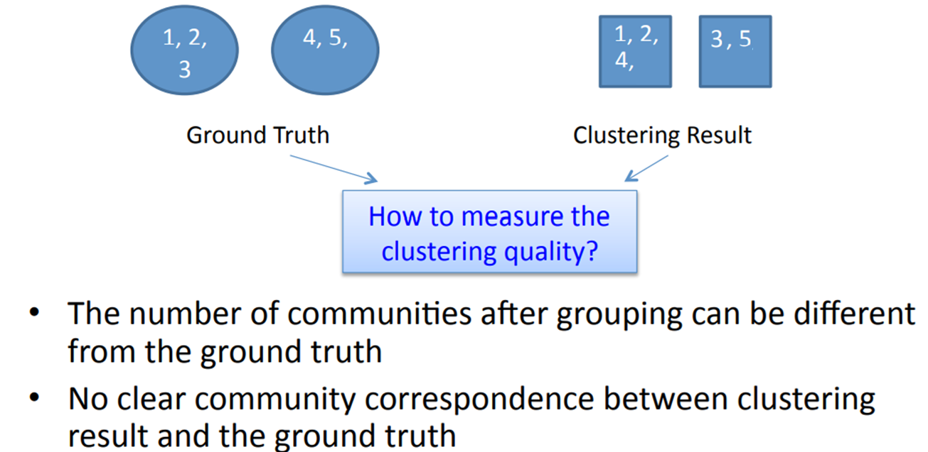
Community evaluation

Slide 43
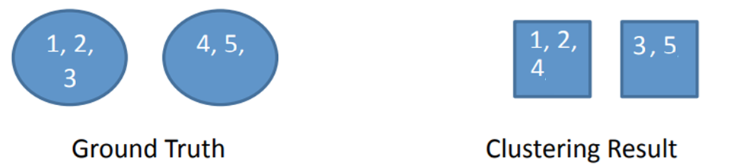
Community evaluation
1. Define Pairs of Points
For evaluating the Rand Index, we consider all possible pairs of points. Here, there are 5 data points, so the number of possible pairs is = 10
The pairs are:
(1, 2), (1, 3), (1, 4), (1, 5), (2, 3), (2, 4), (2, 5), (3, 4), (3, 5), (4, 5)
2. Categorize each pair as one of the following:
True Positive (TP): Both points belong to the same cluster in both ground truth and predicted clusters.
True Negative (TN): Both points belong to different clusters in both ground truth and predicted clusters.
False Positive (FP): Points are in different clusters in the ground truth but are in the same predicted cluster.
False Negative (FN): Points are in the same cluster in the ground truth but are in different predicted clusters.

Slide 44


Community evaluation
3. Evaluate each pair:
(1, 2), (1, 3), (1, 4), (1, 5), (2, 3), (2, 4), (2, 5), (3, 4), (3, 5), (4, 5)
TP= Pair must appear in both ground truth and clustering result
Count the pairs:
TP = 1 (Pair: (1, 2))
TN = 4 (Pairs: (1, 5), (2, 5), (3, 4), (3, 5))
FP = 3 (Pairs: (1, 4), (2, 4), (3, 5))
FN = 2 (Pairs: (1, 3), (2, 3), (4, 5))
4. Rand Index Calculation:

